Slide 1
The Market Basket
What's Up with Prices?

Slide 2
THE MARKET BASKET
History of United States Postage Rates
(Rate for first-class postage for a one-ounce letter)
Date | Rate | Date | Rate
July 6, 1932 | 3 cents | February 3, 1991 | 29 cents
August 1, 1958 | 4 cents | January 1, 1995 | 32 cents
January 7, 1963 | 5 cents | January 10, 1999 | 33 cents
January 7, 1968 | 6 cents | January 7, 2001 | 34 cents
May 16, 1971 | 8 cents | June 30, 2002 | 37 cents
March 2, 1974 | 10 cents | January 8, 2006 | 39 cents
December 31, 1975 | 13 cents | May 14, 2007 | 41 cents
May 29, 1978 | 15 cents | May 12, 2008 | 42 cents
March 22, 1981 | 18 cents | May 11, 2009 | 44 cents
November 1, 1981 | 20 cents | January 22, 2012 | 45 cents
February 17, 1985 | 22 cents | January 27, 2013 | 46 cents
April 3, 1988 | 25 cents | January 24, 2014 | 49 Cents
Source: http://en.wikipedia.org/wiki/History_of_United_States_postage_rates;
http://www.akdart.com/postrate.html.

Slide 3
THE MARKET BASKET
Inflation is a general, sustained upward movement of prices for goods and services in an economy. It is a sustained increase in the price level of goods and services.
The price level is the average of prices at a specific point in time compared with the average of prices at another point in time.
As a result of inflation, it takes more money to buy the same goods and services. Inflation means prices go up!

Slide 4
THE MARKET BASKET
Match the Definition
Objects that satisfy people’s wants
Actions that satisfy people’s wants
People who buy goods and services to satisfy their wants
Services
Goods
Consumers

Slide 5
THE MARKET BASKET
SAME
WORSE OFF
BETTER OFF
Tanika
Joann
Selma
Doug
Allen
Kara
Robert
John

Slide 6
THE MARKET BASKET
SAME
WORSE OFF
BETTER OFF
Tanika
Allen
Robert
Selma
Joann
Doug
John
Kara

Slide 7
THE MARKET BASKET
Bureau of Labor Statistics
The Bureau of Labor Statistics (BLS) is a federal agency that collects and analyzes economic data. It is responsible for measuring labor market activity, working conditions, and price changes in the economy to provide information for private and public decisionmaking.

Slide 8
THE MARKET BASKET
After collecting and analyzing data, the BLS reports price changes using the consumer price index (CPI). The (CPI) is a measure of the average change over time in the prices paid by urban consumers for a market basket of consumer goods and services. The CPI measures changes on a monthly basis.

Slide 9
THE MARKET BASKET
The CPI reflects all the ups and downs of millions of individual prices.
The CPI seldom mirrors a particular consumer's experience.

Slide 10
THE MARKET BASKET
THE ARKET BASKET
The CPI inflation rate can be determined comparing the percentage increase in the price level of goods and services from one time period to another.
Annual CPI Inflation Rate Formula:
CPI later year ─ CPI earlier year CPI earlier year
Inflation
rate
X 100

Slide 11
THE MARKET BASKET
What’s included in the CPI?
The CPI is often referred to as the Headline CPI or the “all items index.” Although it does not include literally all items, it includes a representative selection of consumer goods and services. Items are divided into more than 200 categories, arranged into eight major groups:
Food and beverages
Housing
Apparel
Transportation
Medical care
Recreation
Education and communication
Other goods and services

Slide 12
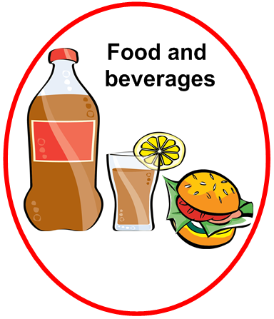
THE MARKET BASKET
THE MARKET BASKET
The Eight Major Groups of the CPI
Food and beverages
Housing
Apparel
Transportation
Medical care
Recreation
Education and communication
Other goods and services
Examples
Breakfast cereal
Milk
Coffee
Chicken
Wine
Full-service meals
Snacks

Slide 13
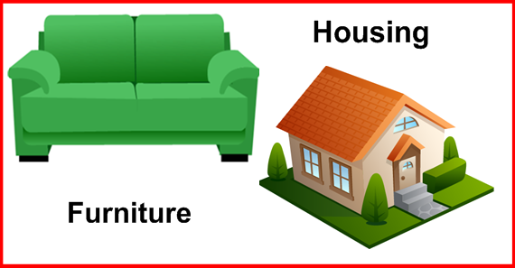
THE MARKET BASKET
THE MARKET BASKET
The Eight Major Groups of the CPI
Food and beverage
Housing
Apparel
Transportation
Medical care
Recreation
Education and communication
Other goods and services
Examples
Rent of primary residence
Owners' equivalent rent
Fuel oil
Bedroom furniture

Slide 14
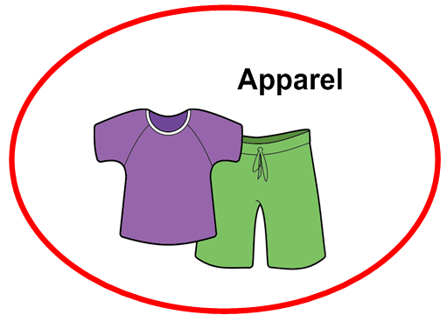
THE MARKET BASKET
THE MARKET BASKET
The Eight Major Groups of the CPI
Food and beverage
Housing
Apparel
Transportation
Medical care
Recreation
Education and communication
Other goods and services
Examples
Men’s shirts
Women’s sweaters
Women’s dresses
Jewelry

Slide 15
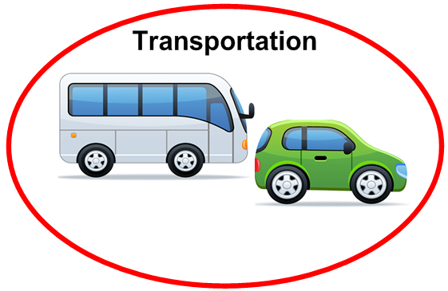
THE MARKET BASKET
THE MARKET BASKET
The Eight Major Groups of the CPI
Food and beverage
Housing
Apparel
Transportation
Medical care
Recreation
Education and communication
Other goods and services
Examples
New vehicles
Airline fares
Gasoline
Motor vehicles
Insurance

Slide 16
THE MARKET BASKET
THE MARKET BASKET
The Eight Major Groups of the CPI
Food and beverage
Housing
Apparel
Transportation
Medical care
Recreation
Education and communication
Other goods and services
Examples
Prescription drugs
Medical supplies
Eyeglasses
Eye care
Hospital services

Slide 17
THE MARKET BASKET
THE MARKET BASKET
The Eight Major Groups of the CPI
Food and beverage
Housing
Apparel
Transportation
Medical care
Recreation
Education and communication
Other goods and services
Examples
Televisions
Toys
Pets and pet products
Sports equipment
Admissions

Slide 18
THE MARKET BASKET
THE MARKET BASKET
The Eight Major Groups of the CPI
Food and beverage
Housing
Apparel
Transportation
Medical care
Recreation
Education and communication
Other goods and services
Examples
College tuition
Postage
Telephone services
Computer software
Computer accessories

Slide 19
THE MARKET BASKET
THE MARKET BASKET
The Eight Major Groups of the CPI
Food and beverage
Housing
Apparel
Transportation
Medical care
Recreation
Education and communication
Other goods and services
Examples
Tobacco
Smoking products
Haircuts
Manicures
Funeral expenses

Slide 20
THE MARKET BASKET
What’s not included in the CPI?
The CPI excludes taxes (such as income and Social Security taxes) not directly associated with the purchase of consumer goods and services.
The CPI does not include investment items, such as stocks, bonds, real estate, and life insurance. (These items relate to savings and not to day-to-day consumption expenses.)

Slide 21
THE MARKET BASKET
The Market Basket
Life insurance
Education and
communication
Apparel
Food and
beverages
Social Security taxes
Medical care
Housing
Transportation
Income tax
Recreation
Other goods
and services

Slide 22
THE MARKET BASKET
What is the core CPI?
The core CPI is the CPI excluding food and energy.
Food and energy prices tend to be more volatile and subject to more price variation. Sharp and often short-term movements can obscure longer-term and underlying trends in other categories.
By excluding food and energy, the core CPI indicates the short-run inflation trend without the risk of volatile prices concealing the true picture of that trend.

Slide 23
THE MARKET BASKET
The Eight Major Groups of the CPI
Food and beverages
Housing
Apparel
Transportation
Medical care
Recreation
Education and communication
Other goods and services

Slide 24
THE MARKET BASKET
What is inflation?
Inflation is a general rise in the level of prices over time. It is a sustained increase in the price level of goods and services.
How does inflation affect purchasing power?
If a consumer's personal income stays the same or increases at a slower rate than inflation, the consumers aren't able to buy the same goods and services. Inflation will also reduce the value of people's savings if the interest rate at which the savings grows is less than the rate of inflation.

Slide 25
THE MARKET BASKET
How is the inflation rate calculated?
The inflation rate is a percentage of change in price level determined by comparing the percentage increase in the price level of goods and services from one time period to another.
What is the CPI and how does it differ from core CPI?
The CPI is a measure of the average change over time in the prices paid by urban consumers for a market basket of consumer goods and services. The CPI measures changes on a monthly basis. The core CPI is the CPI excluding food and energy.

Slide 26
THE MARKET BASKET
What are the categories of consumer spending included in the CPI and the core CPI?
Food and beverages, housing, apparel, transportation, medical care, recreation, education and communication, and other goods and services
What is the role of the BLS?
The BLS is a federal agency that collects and analyzes economic data. It is responsible for measuring labor market activity, working conditions, and price changes in the economy to provide information for private and public decisionmaking.

Slide 27
THE MARKET BASKET
Services
Inflation
CPI
BLS
Consumer
Inflation rate
Core CPI
Goods
Actions that satisfy consumers’ wants
Agency that collects economic data
Percentage change in the average price level
Person who uses goods and services
Measures the change in the price level from one time period to another
Objects that satisfy consumers’ wants
A general rise in prices
The CPI less food and energy

Slide 28
THE MARKET BASKET
Services
Inflation
CPI
BLS
Consumer
Inflation rate
Core CPI
Goods
Actions that satisfy consumers’ wants
Agency that collects economic data
Percentage change in the average price level
Person who uses goods and services
Measures the change in the price level from one time period to another
Objects that satisfy consumers’ wants
A general rise in prices
The CPI less food and energy

Slide 29
THE MARKET BASKET
Directions for Class Memory Game:
The object of the game is to recall the eight groups used to measure the CPI and determine to which of the eight groups each picture belongs.
In numerical order, look at a picture and name the group to which it would belong. After naming the group, click on the picture to check the answer. Click the “back” button and repeat until all eight pictures have been categorized.

Slide 30
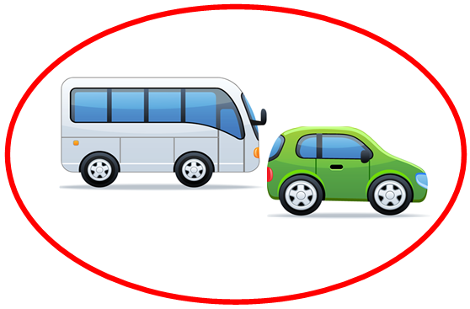
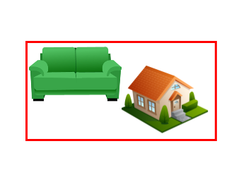
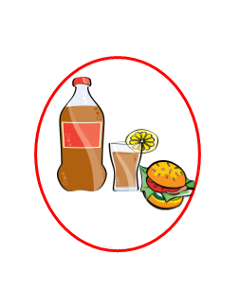
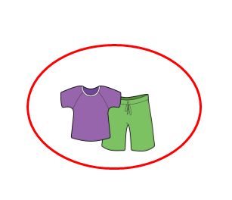
THE MARKET BASKET
1
2
3
4
5
6
8
7

Slide 31
THE MARKET BASKET
Transportation
Back

Slide 32
THE MARKET BASKET
Other goods and services
Back

Slide 33
THE MARKET BASKET
Recreation
Back

Slide 34
THE MARKET BASKET
Housing
Back

Slide 35
THE MARKET BASKET
Food and beverages
Back

Slide 36
THE MARKET BASKET
Medical care
Back

Slide 37
THE MARKET BASKET
Apparel
Back

Slide 38
THE MARKET BASKET
Education and communication
Back

