Slide 1
Principles of Government

Slide 2
What is Government
Government is the institution through which a society makes and enforces its public policies.
Public Policies include taxation, defense, education, crime etc…..

Slide 3
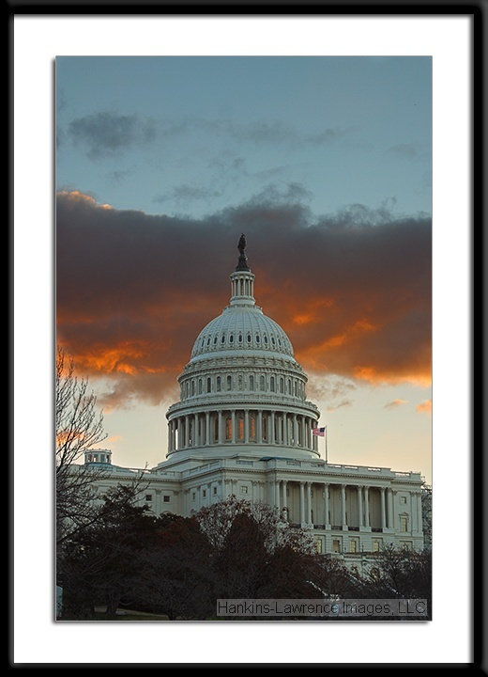
Governmental Powers
Legislative- make laws
Executive- enforces laws
Judicial- interprets laws

Slide 4
The State
State- a body of people, living in a defined territory, organized politically, and with the power to make and enforce laws.
Aristotle- scholar in ancient Greece, first student of gov’t

Slide 5
Characteristics of States
Population – a state must have people.
Territory – a state must have land.
Sovereignty – every state has supreme and absolute power within its territory.
Government – every state is politically organized.

Slide 6
Political Theories
The Force Theory – states are born from force (ex- wars).
The Evolutionary Theory – claims states develop naturally out or the early family.
The Divine Right Theory – God created the state and royal birthline.
The Social Contract Theory – origin of a state is that of the “social contract”

Slide 7
The Purpose of Government
To maintain social order
To provide public services
To provide for national security and common defense
To provide for and control the economic system

Slide 8
Formations of Government
Unitary System- gives all key powers to the nat’l or central gov’t
Federal System- divides the power of gov’t between nat’l and state or local gov’ts
Confederacy- a loose union of independent states

Slide 9
Constitutions and Government
Constitution- a plan that provides the rules for gov’t
Sets out ideas that people bound by the const. believe in and share
Establishes the basic structure of gov’t and defines the gov’ts powers and duties
Provides the supreme law for the country

Slide 10
Constitutions and Gov’t
Constitutional Gov’t- a gov’t in which a const. has authority to place clearly recognized limits on the powers of those who govern.
Constitutions serve as incomplete guides
Preamble- statement of goals
Provides framework/plan for gov’t
Highest law

Slide 11
Types of Government
Anarchy- a situation where there is no gov’t
Communist- gov’t own things like businesses and farms. It provides people w/ healthcare, education, and welfare
Theocracy- gov’t in which religion and gov’t are allied

Slide 12
Types of Government
Dictatorship – rule by one or a few people
Autocracy- power and authority to rules in the hands of a single individual
Monarchy- a king, queen, or emperor exercises supreme powers of gov’t
Absolute Monarch- have complete and unlimited power to rule
Constitutional Monarch- share gov’t powers with elected legislatures.
Oligarchy- a small group holds the power

Slide 13
Types of Gov’t
Democracy- any system of gov’t in which rule is by the people
Direct Democracy- people govern themselves by voting on issues individually as citizens
Representative Democracy- people elect reps and give them the power to make laws and conduct gov’t

Slide 14
Foundations of Democracy
Worth of the individual- liberty
Active citizen participation
Majority rules, minority rights
Necessity of compromise (political parties)
Free elections- one person, one vote
Favorable economy
Widespread education
Social consensus

Slide 15
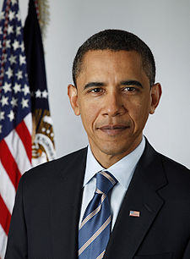
Presidential Government
Executive and Legislative branches of government are separate and independent of one another and coequal.
Checks and Balances maintain the overall balance of power in this type of government.

Slide 16
Parliamentary Government
The Executive Branch is comprised of a prime minister and his cabinet.
The Parliament (Legislative) is the more powerful branch, therefore, prolonged conflict and deadlock are less likely to occur between the executive and legislative branches.

