Slide 1
THE BUSINESS CYCLE

Slide 2
THROUGHOUT OUR HISTORY

Slide 3
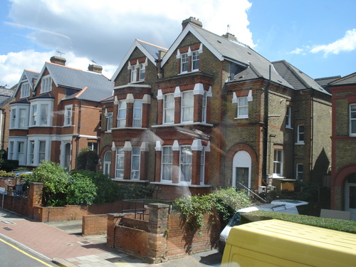
GOOD TIMES

Slide 4
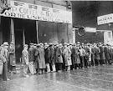
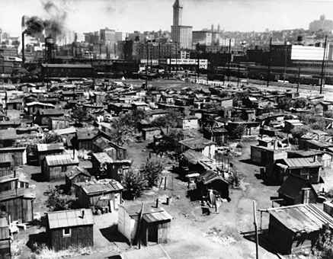
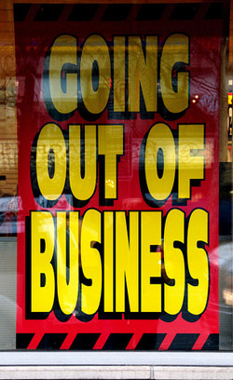
HARD TIMES
1930’s
The Great Depression

Slide 5
GOOD TIMES and BAD TIMES

Slide 6
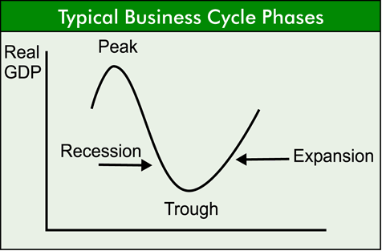
THE BUSINESS CYCLE
TIME

Slide 7
EXPANSION/RECOVERY
Expansion is economic growth
Times of prosperity.
Leads to Inflation – increase in prices (because suppliers want to charge the highest possible price for a product)
Contributing Factor:
Business Investment
Cycle Indicators:
Stock Market

Slide 8
PEAK
The highest point between the end of an economic expansion and the start of a contraction in a business cycle. The peak of the cycle refers to the last month before several key economic indicators, such as employment and new housing starts, begin to fall. It is at this point that real GDP spending in an economy is its highest level.
Contributing Factor:
Interest Rates and Credit
Cycle Indicators:
Interest Rates

Slide 9
CONTRACTION/RECESSION
Recession is a decline in business activity.
A recession that continues for too long can become a depression.
Contributing Factors:
Consumer Expectations
Cycle Indicators:
Manufacturers new orders of capital goods

Slide 10
TROUGH (Troff)
The stage of the economy's business cycle that marks the end of a period of declining business activity and begins the transition to expansion.

Slide 11
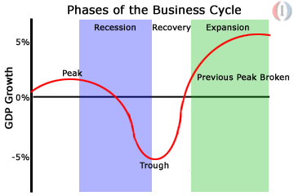
BUSINESS CYCLE
The continuous sequence of ups and downs in the economy.

Slide 12
AGGREGATE DEMAND
What Does Aggregate Demand Mean? The total amount of goods and services demanded in the economy at a given overall price level and in a given time period. It is represented by the aggregate-demand curve, which describes the relationship between price levels and the quantity of output that firms are willing to provide. Normally there is a negative relationship between aggregate demand and the price level.
Also known as "total spending".

Slide 13
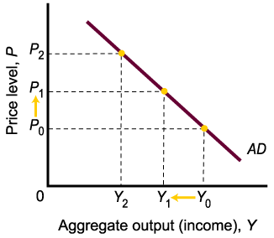
AGGREGATE DEMAND
Aggregate demand is the total demand for goods and services in the economy.
The aggregate demand (AD) curve is a curve that shows the relationship between the price level and the quantity of real GDP demanded by households, firms, and the government.

Slide 14
AGGREGATE DEMAND
Aggregate demand is the demand for the gross domestic product (GDP) of a country, and is represented by this formula: Aggregate Demand (AD) = C + I + G + (X-M)
C = Consumers' expenditures on goods and services.
I = Investment spending by companies on capital goods.
G = Government expenditures on publicly provided goods and services.
X = Exports of goods and services.
M = Imports of goods and services.

Slide 15
AGGREGATE SUPPLY
What Does Aggregate Supply Mean? The total supply of goods and services produced within an economy at a given overall price level in a given time period. It is represented by the aggregate-supply curve, which describes the relationship between price levels and the quantity of output that firms are willing to provide. Normally, there is a positive relationship between aggregate supply and the price level. Rising prices are usually signals for businesses to expand production to meet a higher level of aggregate demand. Also known as "total output".

Slide 16
AGGREGATE SUPPLY
Price Level
In the short run, the aggregate supply curve (the price/output response curve) has a positive slope.
At low levels of aggregate output, the curve is fairly flat. As the economy approaches capacity, the curve becomes nearly vertical. At capacity, the curve is vertical.
AS
Real GDP Y

Slide 17
AGGREGATE SUPPLY
A shift in aggregate supply can be attributed to a number of variables. These include
changes in the size and quality of labor, technological innovations, increase in wages, increase in production costs,
changes in producer taxes and subsidies, and changes in inflation.
In the short run, aggregate supply responds to higher demand (and prices) by bringing more inputs into the production process and increasing utilization of current inputs.
In the long run, however, aggregate supply is not affected by the price level and is driven only by improvements in productivity and efficiency.

Slide 18
SHIFTS IN AS AND AD

Slide 19
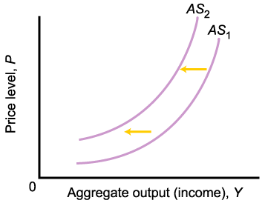
AGGREGATE SUPPLY
A decrease in costs, economic growth, or public policy, can cause a rightward shift of the AS curve.
A leftward shift of the AS curve could be caused by cost shocks.

Slide 20
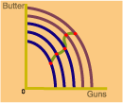
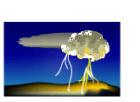
AGGREGATE SUPPLY
Factors That Shift the Aggregate Supply Curve
Shifts to the Right Increases in Aggregate Supply
Shifts to the Left Decreases in Aggregate Supply
Lower costs
Higher costs
lower input prices
higher input prices
lower wage rates
higher wage rates
Economic growth
Stagnation
more capital
Capital deterioration
more labor
technological change
Public policy
Public policy
supply-side policies
waste and inefficiency
tax cuts
over-regulation
deregulation
Good weather
Bad weather, natural disasters, destruction b/ wars

Slide 21
EQUILIBRIUM IN AS/AD
P0 and Y0 correspond to equilibrium in the goods market and the money market and a set of price/output decisions on the part of all the firms in the economy.
Price Level
AS
P0
AD
Y0
Real GDP Y

Slide 22
AS/AD QUIZ
Use an aggregate demand and aggregate supply diagram to illustrate and explain how each of the following will affect the equilibrium price level and real GDP:
Consumers expect a recession
Foreign income rises
Foreign price levels fall
Government spending increases
Workers expect high future inflation and negotiate higher wages now
Technological improvements increase productivity
We will answer each of these questions step-by-step. First, however, we need to set up what an aggregate demand and aggregate supply diagram looks like. We will do that in the next section.

Slide 23
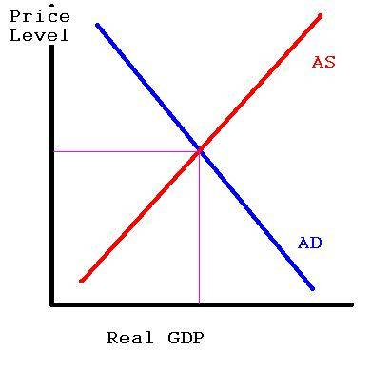
AS/AD QUIZ

Slide 24
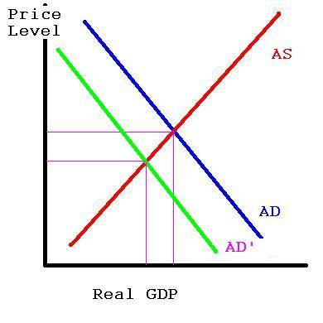
AS/AD QUIZ
Consumers expect a recession
If consumer expect a recession then they will not spend as much money today as to "save for a rainy day". Thus if spending has decreased, then our aggregate demand must decrease. An aggregate demand decrease is shown as a shift to the left of the aggregate demand curve, as shown below. Note that this has caused both Real GDP to decrease as well as the price level. Thus expectations of future recessions act to lower economic growth and are deflationary in nature.

Slide 25
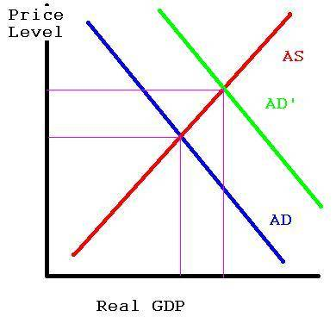
AS/AD QUIZ
Foreign income rises
If foreign income rises, then we would expect that foreigners would spend more money - both in their home country and in ours. Thus we should see a rise in foreign spending and exports, which raises the aggregate demand curve. This is shown in our diagram as a shift to the right. This shift in the aggregate demand curve cause Real GDP to rise as well as the price level.

Slide 26
AS/AD QUIZ
Foreign price levels fall
If foreign price levels fall, then foreign goods become cheaper. We should expect that consumers in our country are now more likely to buy foreign goods and less likely to buy domestic made products. Thus the aggregate demand curve must fall, which is shown as a shift to the left. Note that a fall in foreign price levels also causes a fall in domestic price levels (as shown) as well as a fall in Real GDP, according to this Keynesian framework.

Slide 27
AS/AD QUIZ
Government spending increases
This is where the Keynesian framework differs radically from others. Under this framework this increase in government spending is an increase in aggregate demand, as the government is now demanding more goods and services. So we should see Real GDP rise as well as the price level. This is generally all that is expected in a 1st year college answer. There are larger issues here, though, such as how is the government paying for these expenditures (higher taxes? deficit spending?) and how much government spending chaces away private spending. Both those are issues typically beyond the scope of a question such as this.

Slide 28
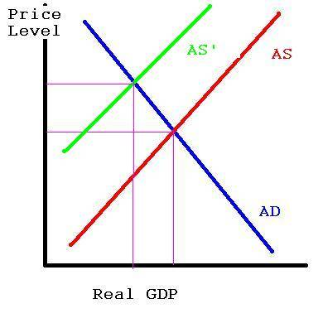
AS/AD QUIZ
Workers expect high future inflation and negotiate higher wages now
If the cost of hiring workers has gone up, then companies will not want to hire as many workers. Thus we should expect to see the aggregate supply shrink, which is shown as a shift to the left. When the aggregate supply gets smaller, we see a reduction in Real GDP as well as an increase in the price level. Note that the expectation of future inflation has caused the price level to increase today. Thus if consumers expect inflation tomorrow, they will end up seeing it today.

Slide 29
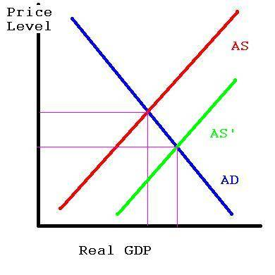
AS/AD QUIZ
Technological improvements increase productivity
A rise in firm productivity is shown as a shift of the aggregate supply curve to the right. Not surprisingly, this causes a rise in Real GDP. Note that it also causes a fall in the price level.

